Slide 1
ECO Countries & Tourism: A Regional Approach
Shabnam Bahrami-Shabstari

Slide 2
Welcome To Tehran

Slide 3
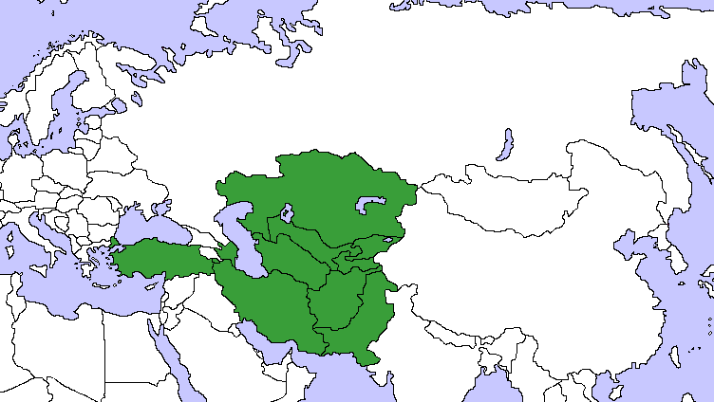

Slide 4
From Black Sea to India OCEAN
ECO Countries create a unique geopolitical phenomenon A Total Population of 450 million speaking several different languages and encompassing a diverse cultural tradition
Offering both old and new in arts, architecture and monuments.
A four season climate making several recreational activities possible at any given time of year.

Slide 5
Tourism in ECO Countries
A total of 52 million tourists have visited ECO countries in 2012

Slide 6
Data ambiguities
Data on tourism in ECO countries is ambiguous
UNWTO reports for ECO countries are not complete.
Kazakhestan’s data reports different statistics.
There is no data available on Afghanistan and Turkmenistan.
Tajikistan: the only data reported for Tajikistan is provided by the World Bank.

Slide 7
ECO Within Tourism
Iran and Turkey have the highest volume of bilateral traffic.
1.1 million Iranians have visited Turkey in 2011.
There are a large number of travels between neighboring countries such as Iran-Afghanistan, Iran-Pakistan which is undocumented.

Slide 8
Success Examples
295 Million tourists have visited Turkey.
It ranks 6th globally in hospitality indexes.
Tourism growth rate averages 11% to 14%.

Slide 10
Success Lessons
What Turkey has done right?
Regional Marketing
Brand Recognition
Eliminating Trade Barriers
Developing Infrastructure
Private Sector Development

Slide 11
Regional Marketing
Turkey does welcome tourists from neighboring countries.
Demand from Iran and Bulgaria remains strong.
10% of the total demand, given Bulgaria’s weak economy and Iran’s devaluation of IRR that is an important.

Slide 12
Brand Recognition
Using globally recognizable symbols to promote tourism
Becoming Europe’s Cultural Capital
Campaigning to host international competition such as Olympic Games and the World Cup.

Slide 13
Eliminating Trade Barriers
Eliminating visa for foreign travelers
Eliminating visa barriers have increased the number of visitors from Iran and Bulgaria
Azerbaijan implementing visa requirements for Nakhchivan hurt the tourism industry.
Providing flights and transportation services at competitive prices to neighboring countries

Slide 14
Developing infrastructure
Attracting investment, both domestic and international, to construct hotels and resorts.
Establishing a 4 stars airline to facilitate travel and give access to markets in other countries.

Slide 15
Private Sector Development
Promoting private enterprises in all aspects of tourism
Hotels: at all levels and styles from pension houses to five starts hotels.
Airlines: besides Turkish Airlines private airlines have entered the market.
Resorts: expanding the existing ones and developing new ones.

Slide 16
A Regional Outlook
Outside Turkey others countries have implemented similar programs:
Azerbaijan has implemented electronic visa and Kazakhstan eliminated visa for 47 nationalities.
Turkey, Iran & Kazakhstan have developed a comprehensive strategy to promote health and eco tourism.
Pakistan has launched tourism centers and countrywide reservation service.

Slide 17
A Regional Strategy
Time has come for a regional strategy.
ECO members plans and ambitions in tourism sector can only be successful if they cooperate.
A unified regional strategy should be adopted to expand regional market and to eliminate market barriers.

Slide 18
Regional Market
Eliminating Trade Barriers
Learning from Turkey and Azerbaijan’s experiences reducing visa barriers would increase demand for regional tourism across ECO countries.
The largest potential demand to visit ECO countries can come from their own neighboring countries.

Slide 19
Regional Market..
Expand Regional Market
Adopting Open Sky Policy will increase the volume of air travels by reducing the cost of operations.
Looking beyond ECO countries to include non ECO countries and to provide visa privileges to their citizens.

Slide 20
Regional Market…
Youth Tourism
The youth are becoming ardent travelers.
Given the average age of population of ECO region it is time to promote youth tourism.
Health Tourism
Promoting health tourism to increase the social stakeholders in tourism industry and attract more resources to this sector.

Slide 21
First Steps
To Create an ECO Countries Tourism Data Center
ECO Counties can benefit from such center it will facilitate:
Planning and Collaboration
Investment
Professional Training Programs

Slide 22
First Steps
Establishing ECO Countries Hotel Owners Association.
To provide a platform for sharing experience and knowledge.
To establish a network of private businesses and individuals with the means and motivation to promote tourism.

Slide 23
Conclusion
Establishing ECO Countries Hotel Owners Association and Data Center as a first step during this assembly is feasible and recommended.
Iranian Association of Hotel Owners invite members of similar organizations to Tehran to launch this association.

Slide 24
Thank You
The past decade has shown us that the future is bright. Let’s welcome it together.

